Slide 1

Starter Activity - can you decode the below?
01010111 01100101 01101100 01100011 01101111 01101101 01100101 00100000 01000011 01101100 01100001 01110011 01110011 00001010

Slide 2

Digital Environments

Slide 3

Learning Objectives
Understand the features and use of different types of hardware devices

Slide 4
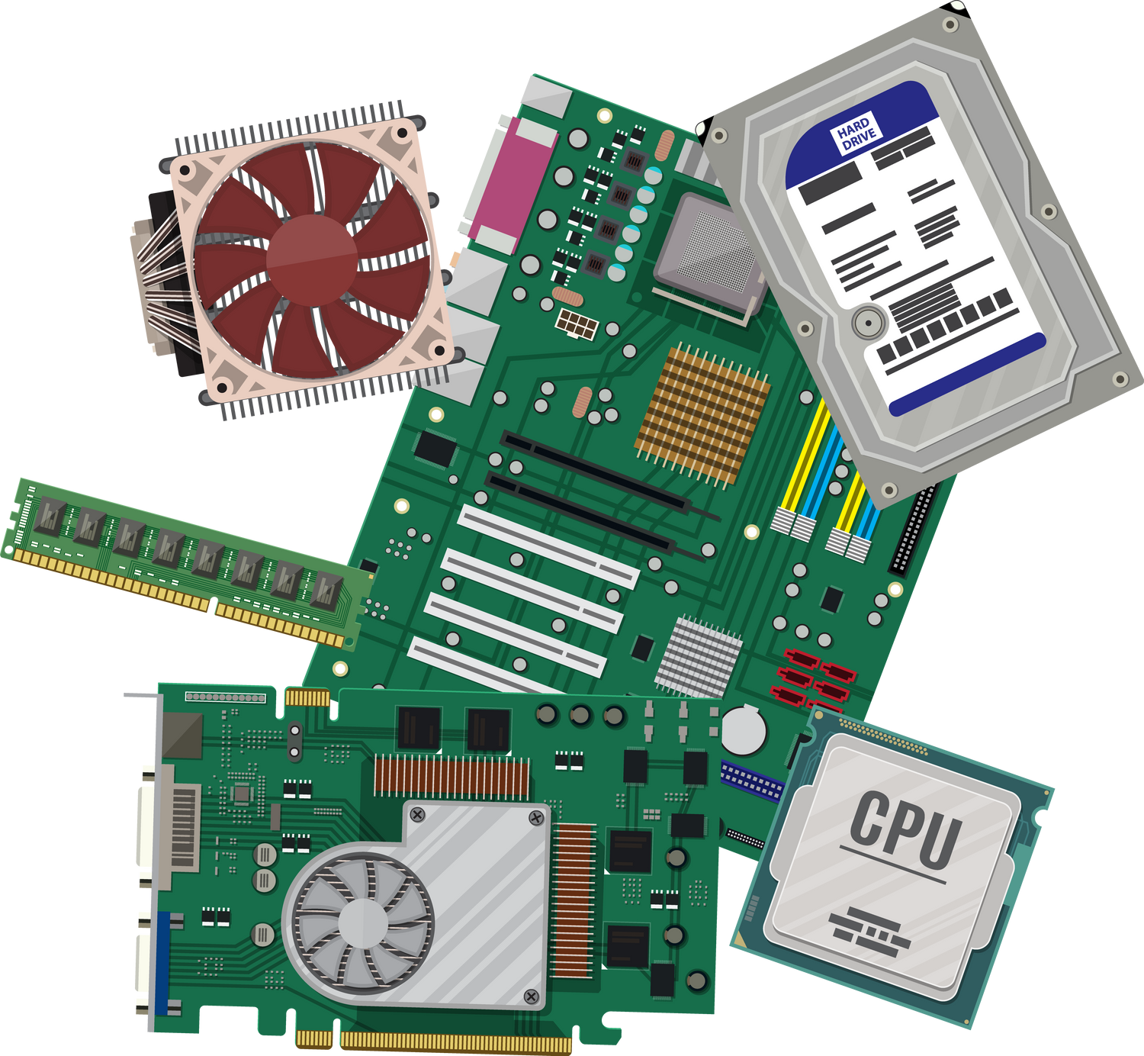
Hardware

Slide 5
Quick Fire Round
List the 4 types of devices we went over last lesson
I’m the brain of a PC, what am I?
I forget everything when you turn me off. What am I?
I use electrical signals to store and retrieve data. What am I?
Notes:
Discuss in groups or with the person next to you where you see computers in daily life and what types you might see (10 mins)
Practical - take PC with you and show different parts

Slide 6
Quick Fire Round
I’m magnetic, but slower to write things because I use a mechanical disk. What am I?
I store permanent instructions. What am I?
I’m a separate card, often with my own memory that allows you to see things. What am I?
Some call me the nervous system of a PC. What am I?
Notes:
Discuss in groups or with the person next to you where you see computers in daily life and what types you might see (10 mins)
Practical - take PC with you and show different parts

Slide 7


Input and output devices
Notes:
Input devices are what they say on the tin - they allow you to input into computers
These can be
-keyboards
-microphones
-touchscreen
-graphics tablets
etc

Slide 8
Input, Output, or Other?
Keyboard | Touchscreen | GPU
Printer | NAS | SAN
Temperature Sensor | VR headset | Braille display
Biometric Scanner | Microphone | Drawing tablet
Notes:
Work in groups to categorise each of these device types

Slide 9
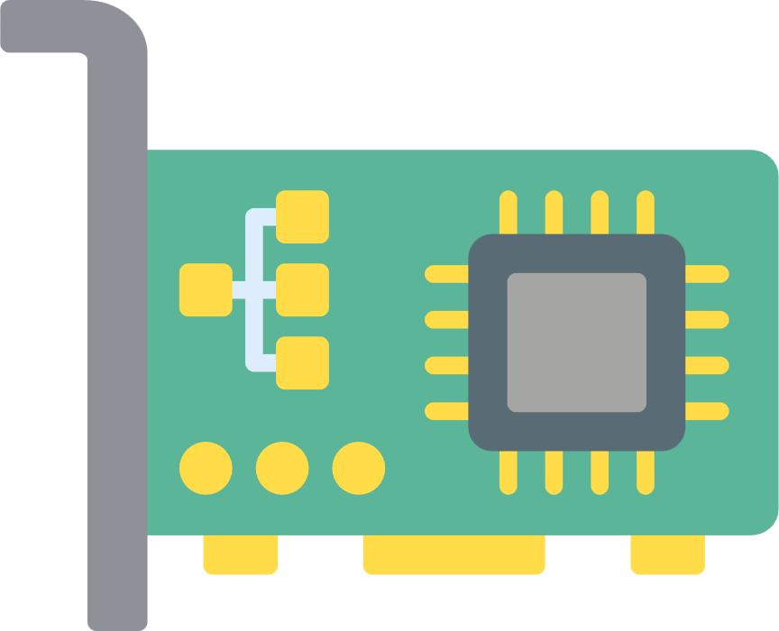
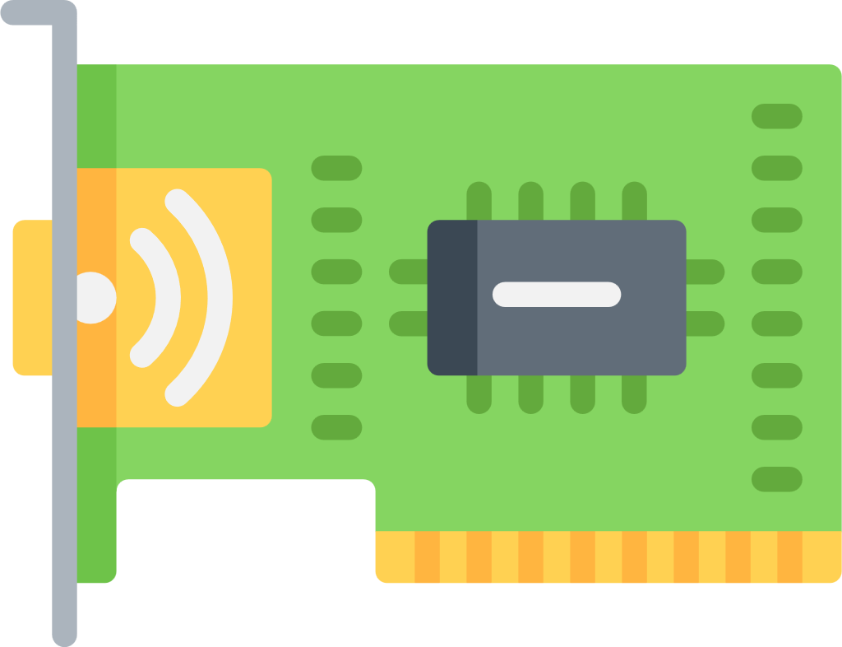
Network Interface Cards
Notes:
A NIC is like your computer’s passport to the network — without it, your PC can’t ‘speak’ to other devices
Why might you choose wireless over LAN?

Slide 10
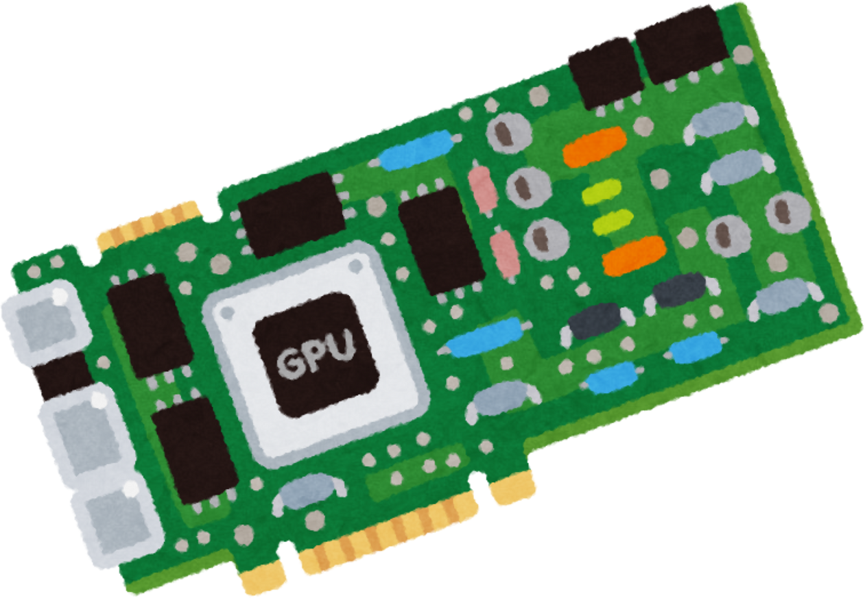
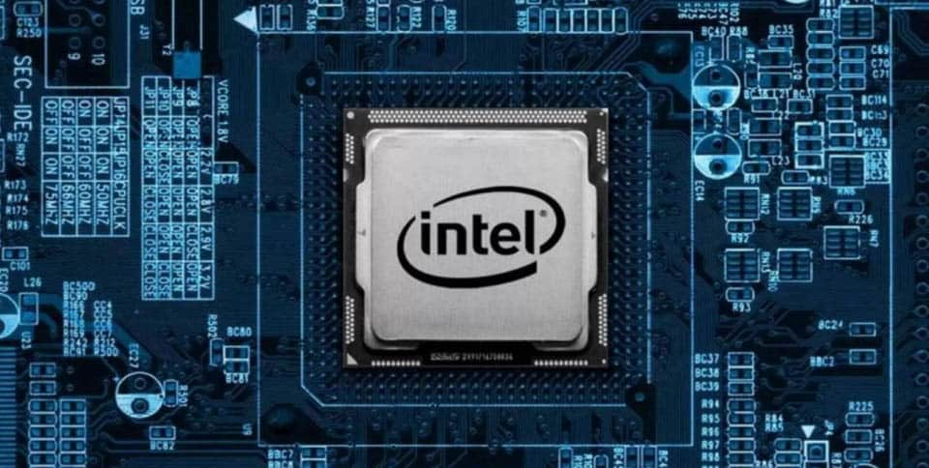
Graphics Processing Units
Notes:
Graphics processing unit
Dedicated unit for processing graphics
Why are GPU's better than integrated graphics?
Office admin worker vs Graphics designers

Slide 11


PCI-e and USB
Notes:
Peripheral Component Interconnect - port on a motherboard that allows you to plug in components such as graphics, sound cards, network cards
Universal Serial Bus - allows you to plug devices into a PC (different standards of USB such as USB 3)

Slide 12

Why might a PC overheat?
Notes:
Why might a PC overheat?
-dust
-component failure
-environment issues i.e. lack of aircon or bad positioning
-running too much at once

Slide 13
Poor Airflow
Dust
Bad cooling
High workload
Bad positioning
Cats
Notes:
Why might a PC overheat?
-fun reasons
Animals sleeping on them, too many RGB lights, direct sunlgight

Slide 14
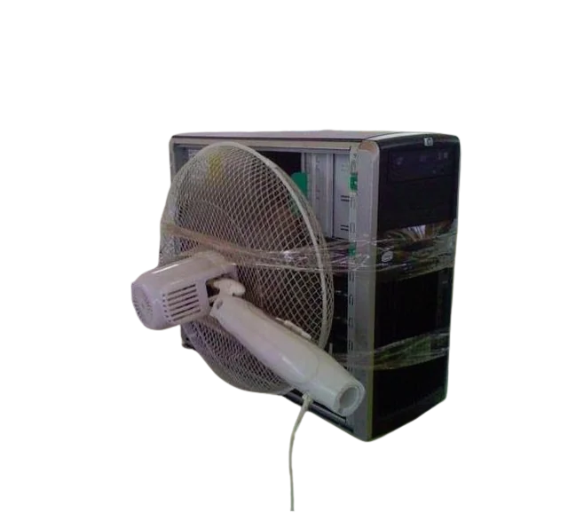
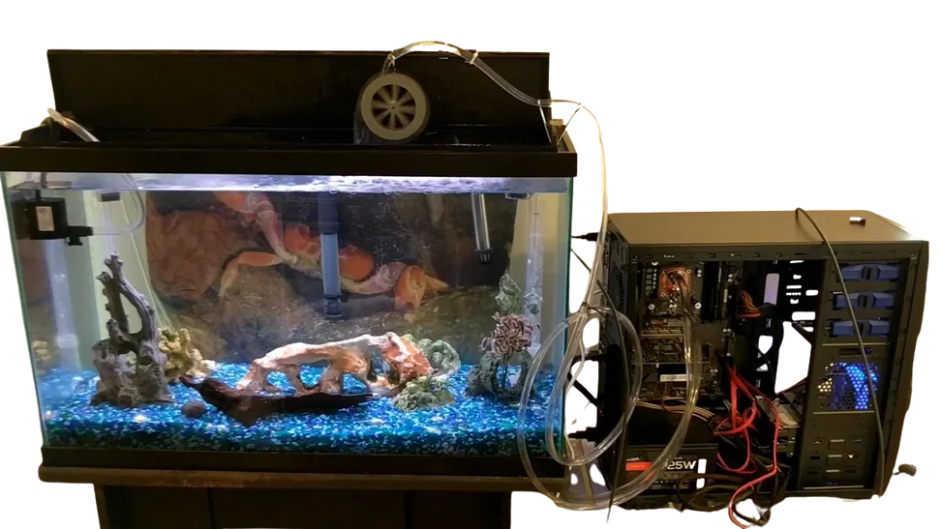
Cooling

Slide 15
Air Cooling
Pros
Cheap, easy to install, relatively reliable
Cons
Not suitable for high performance CPU’s or overclocking, Noisy at high speeds
Notes:
Heat is transferred from the CPU/GPU to a metal heatsink (often copper/aluminium).
A fan blows air over the heatsink to carry heat away.
Case fans circulate air in/out of the case

Slide 16
Liquid cooling
Pros
Better heat transfer, quieter, supports overclocking
Cons
Expensive, needs more maintenance, risk of leaks
Notes:
Liquid (usually water with additives) circulates through tubes.
It absorbs heat from a water block on the CPU/GPU.
The heated liquid flows to a radiator where fans cool it.
The cooled liquid cycles back to the CPU/GPU

Slide 17
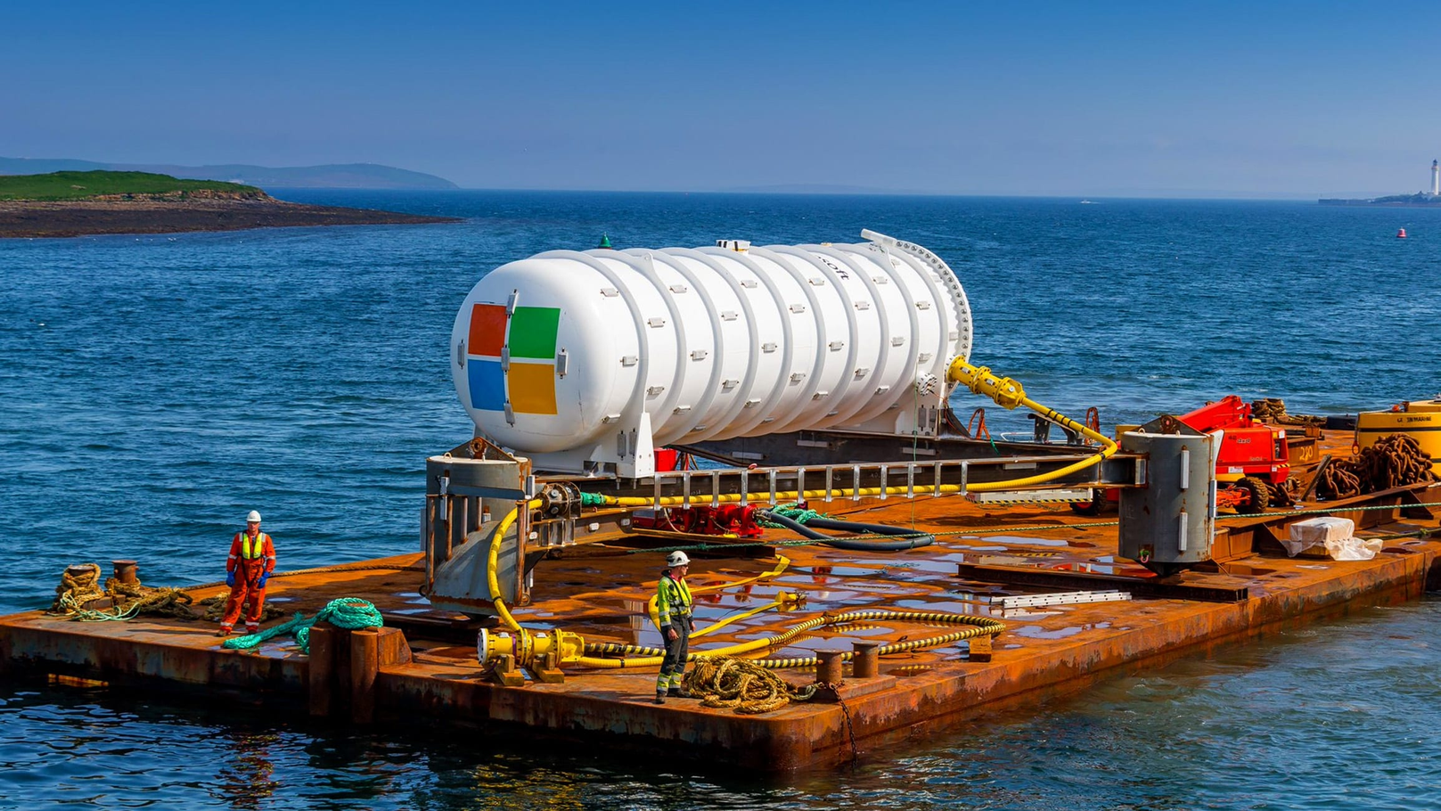
Microsoft Project Natik
Notes:
https://news.microsoft.com/source/features/sustainability/project-natick-underwater-datacenter/
passive cooling

Slide 18



Sensors
Notes:
All sensors are either passive or active
Passive sensors do not need an external power connection, whereas in the case of active sensors it is quite the opposite - these require a source of power to operate.

Slide 19


Passive and Active
Notes:
Active: It sends out its own signal (like light, sound, or radio waves) and then measures how that signal bounces back.
Passive: It does not send anything out. It just waits and measures what’s already there.

Slide 20


Analogue and digital
Notes:
Analogue: Works with smooth, continuous signals (like a dimmer switch – can be anywhere between off and bright).
Digital: Works with discrete steps, usually numbers (like a light switch – only ON or OFF, or steps in between).

Slide 21
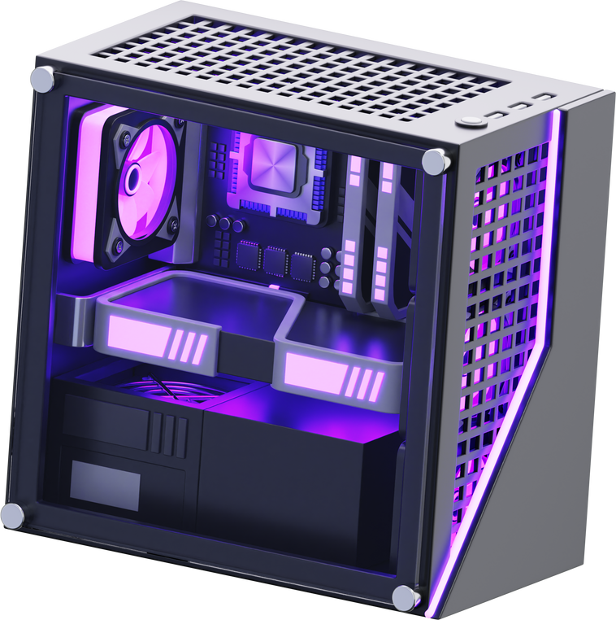


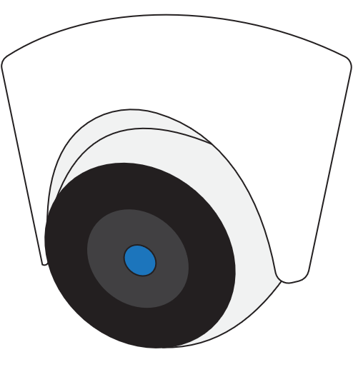
Thermal
Motion
Humidity
Light
Voltage/Power
Notes:
Types: temperature, motion, proximity, GPS, accelerometer
Where might these be used and what every day objects have these?

Slide 22

How do sensors and cooling work together?
Notes:
Sensors detect conditions (temperature, fan speed).
Cooling systems respond (increase fan speed, activate liquid pump).
If sensors detect unsafe conditions → system may throttle performance or shut down

Slide 23
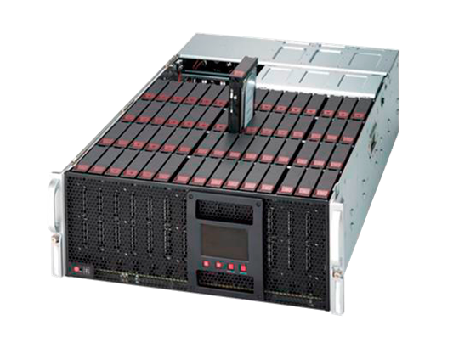
Redundant Array of Independent Disks, AKA RAID
Notes:
Sensors detect conditions (temperature, fan speed).
Cooling systems respond (increase fan speed, activate liquid pump).
If sensors detect unsafe conditions → system may throttle performance or shut down

Slide 24
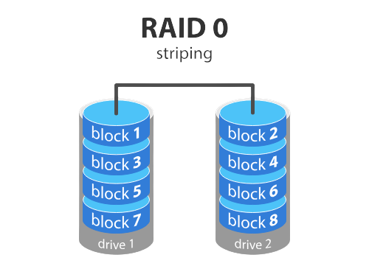
RAID 0
Notes:
Sensors detect conditions (temperature, fan speed).
Cooling systems respond (increase fan speed, activate liquid pump).
If sensors detect unsafe conditions → system may throttle performance or shut down

Slide 25
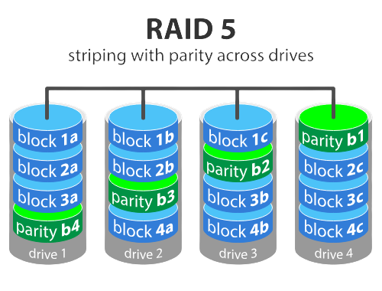
RAID 5
Notes:
Parity - stashing information in an a section in case another disk breaks. Allows you to check what's missing and rebuild data

Slide 26
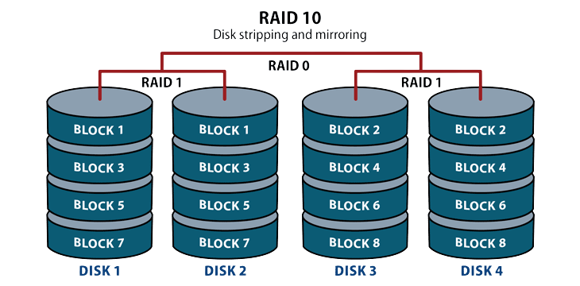
RAID 10

Slide 27
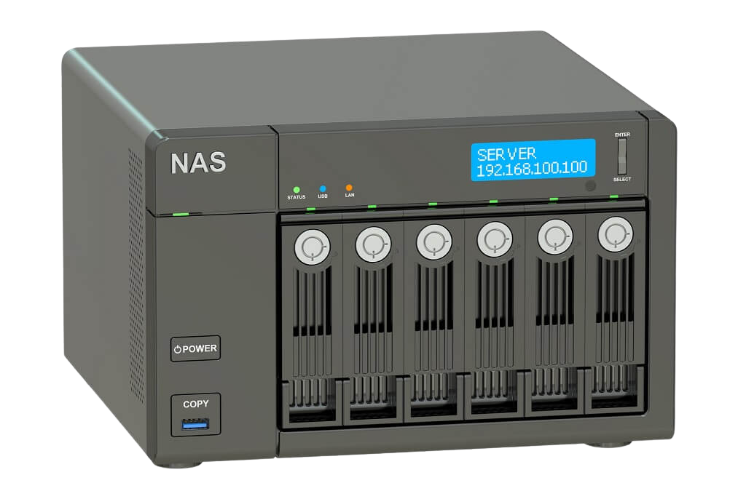
NAS - Network Attached Storage
Notes:
Think of NAS like a shared bookshelf in your house:
You and your family can connect over the network and grab books (files).
It works over regular Ethernet (like your Wi-Fi or home network).
It’s file-level storage: you ask for a file, and it gives you the file.
Easy to set up and use, usually cheaper.
Example: Your office uses NAS to store shared documents, videos, or backups

Slide 28
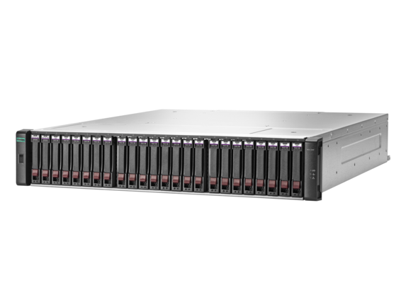
SAN - Storage Attached Network
Notes:
Think of SAN like a super-fast private library with a secret hallway just for computers:
It connects directly to servers, often using Fibre Channel or fast network connections.
It’s block-level storage: your server sees the storage like it’s a local hard drive.
Faster than NAS and better for databases or applications that need super-fast access.
More expensive and complex

Slide 29
Research Task
You are an IT consultant. Your client needs advice on storage solutions. Using your what you have just learned, decide the best option for each scenario.
For each scenario, you only need to provide:
Recommended storage solution (RAID/NAS/SAN).
Reasoning in 1–2 sentences (e.g., why it fits speed, reliability, or cost requirements).
RAID level if applicable.
Notes:
Think of SAN like a super-fast private library with a secret hallway just for computers:
It connects directly to servers, often using Fibre Channel or fast network connections.
It’s block-level storage: your server sees the storage like it’s a local hard drive.
Faster than NAS and better for databases or applications that need super-fast access.
More expensive and complex

Slide 30

Lab Activity
Notes:
Stretch: Which components could you over spec now to save costs later?
What component is likely to be the bottle neck in your system?
Could you improve one component without introducing a cost?

